Slide 1
Amazing Adventure
Chau Thinh - ITCSIU22240
Vo Gia An - ITCSIU22241

Slide 2
Outline
Introduction
Rules and gameplay
Game technique
Conclusion

Slide 3
Introduction
Apply knowledge learned in theoretical OOP classes to make games
Implemented libraries

Slide 4
Rules and gameplay
W: Move Up
S: Move Down
A: Move Left
D: Move Right
I: Inventory
P: Pause the game
Enter: Melee attack (Enabled when Player gets the Axe) / Interact with NPC
F: Fire FireBall (Enabled when Player gets the Red Potion)

Slide 5
Rules and gameplay
Gameplay:
Objective: Explore the entire map and reach the Room to win.
Tasks:
Find keys to open chests.
Chests may contain buffs or an IronKey.
Use the IronKey to open the Last Door and win.
Power-ups:
Red Potion: Enables shooting FireBalls.

Slide 6
Rules and gameplay
Challenges:
Monsters roam the map.
Kill monsters to open chests easily.
Pick up an Axe to kill monsters.
Use Axe to cut down Dry Trees.
Boss Battle:
Skeleton Boss guards the Goal.
Beat the Skeleton Boss to win the game.

Slide 7



Technology used in the project

Slide 8
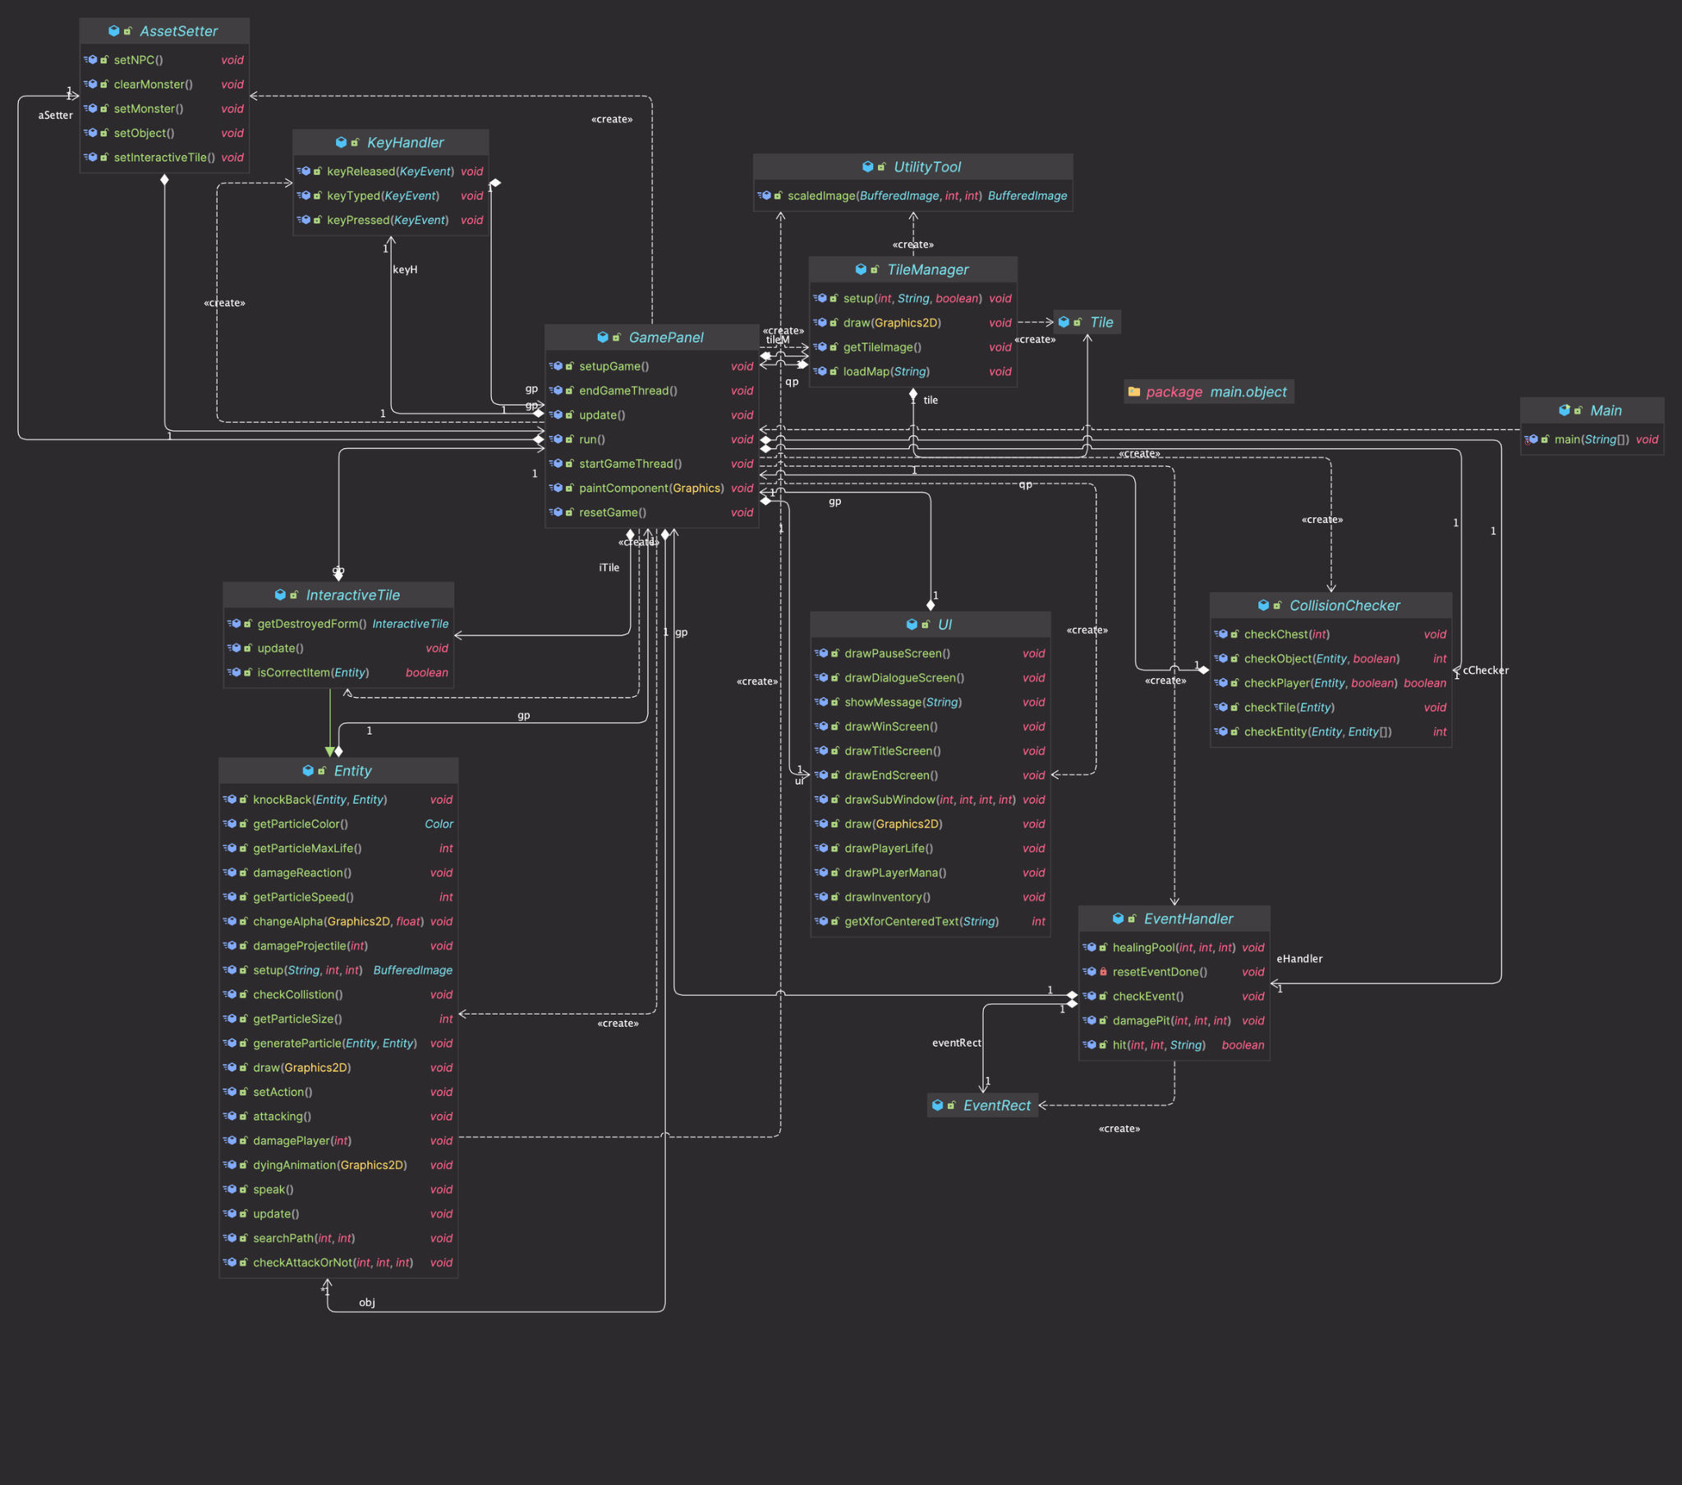
UML Diagrams

Slide 9
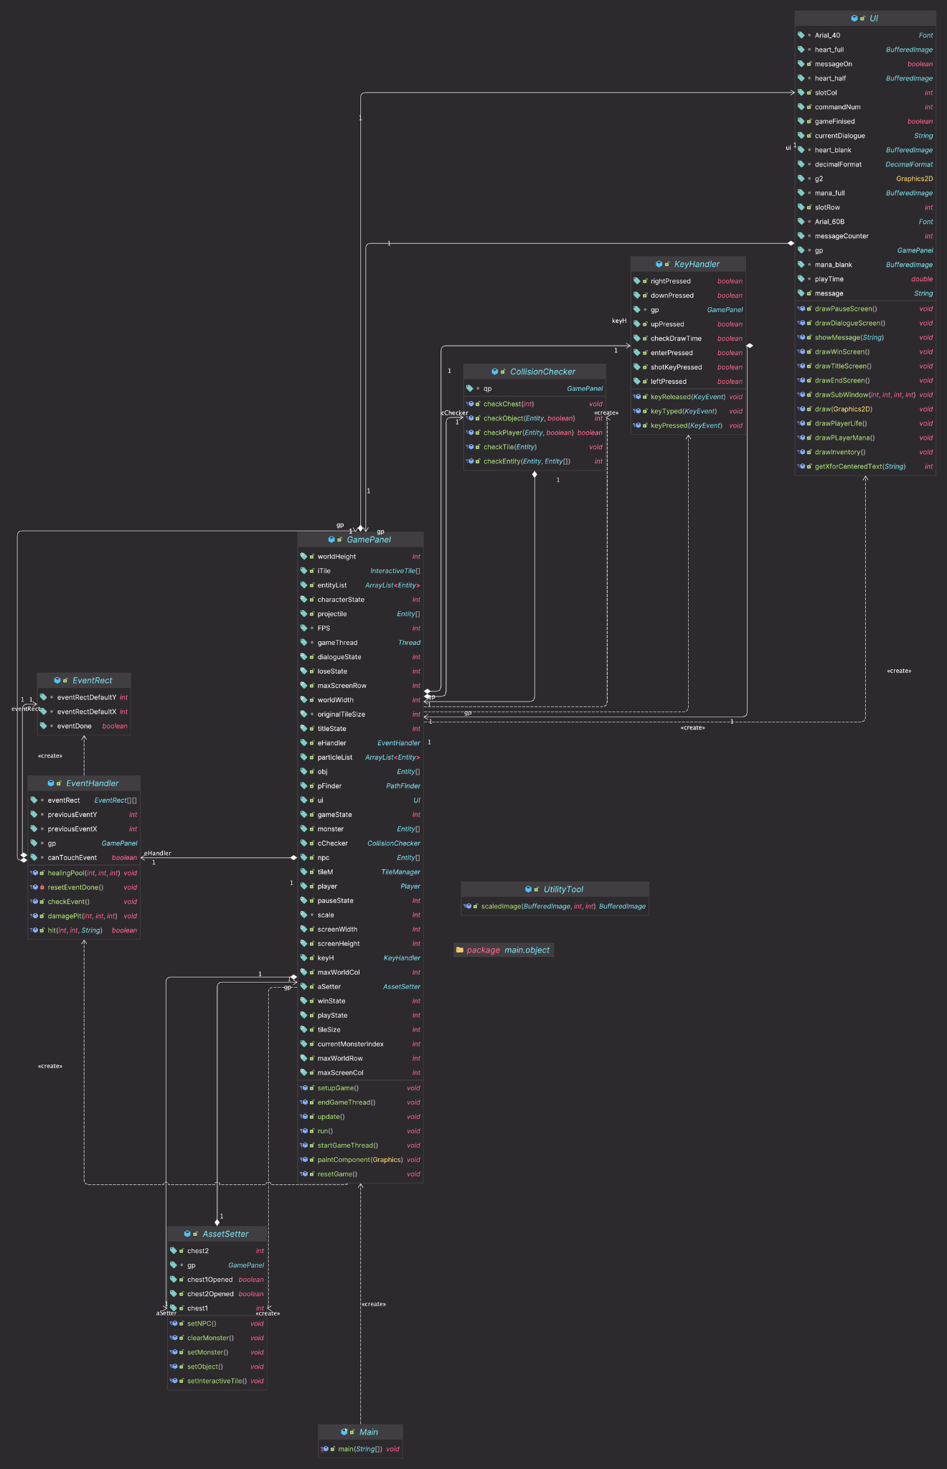
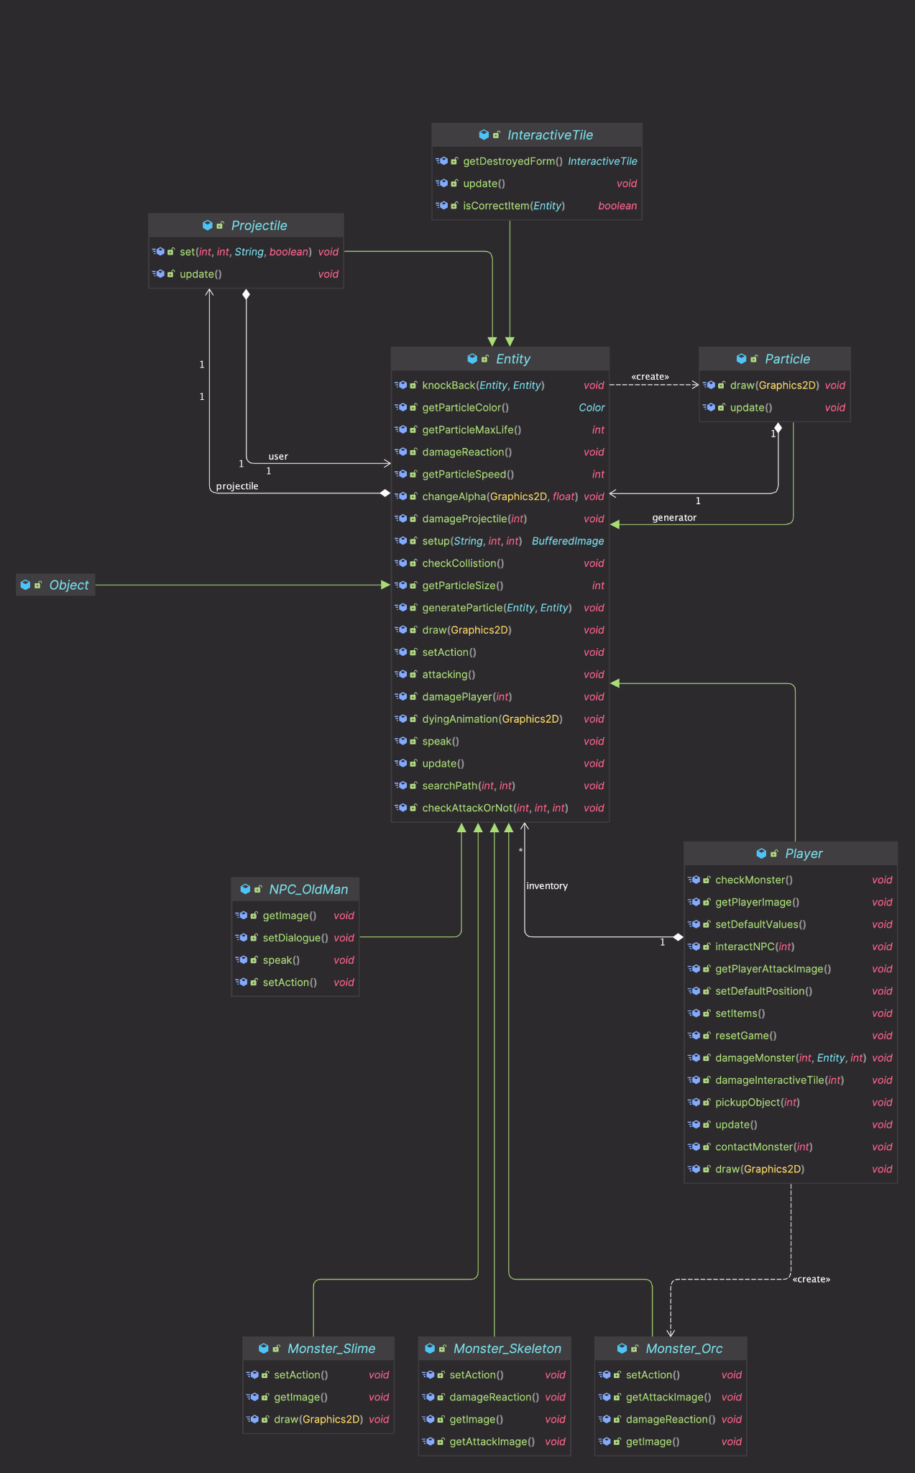

Slide 10
DEMO

Slide 11
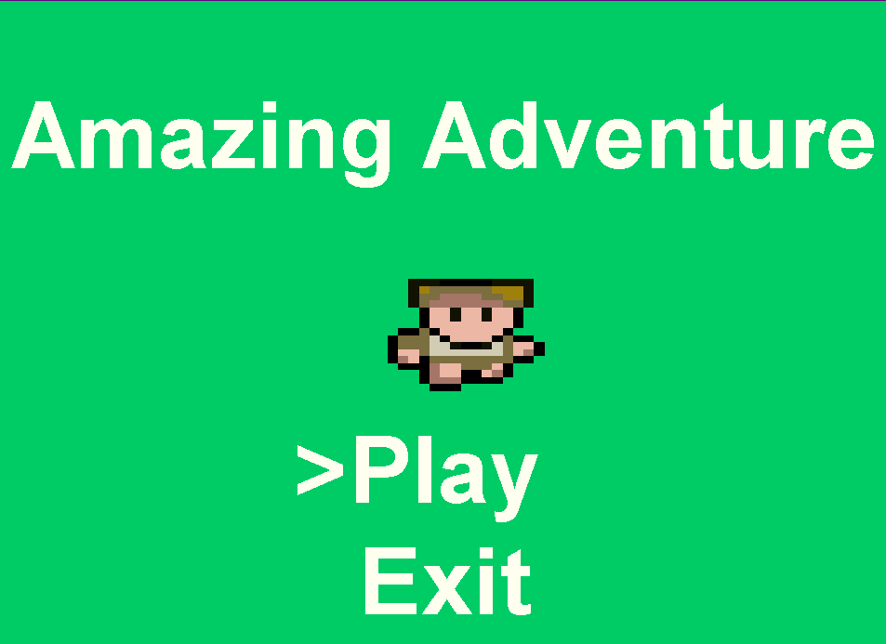

Slide 12
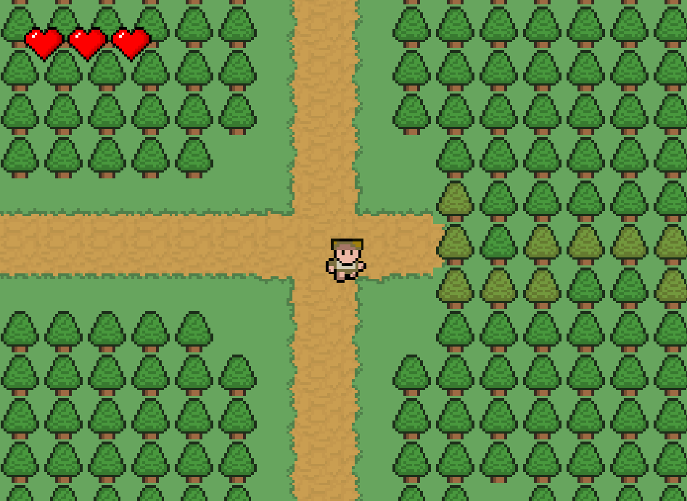

Slide 13
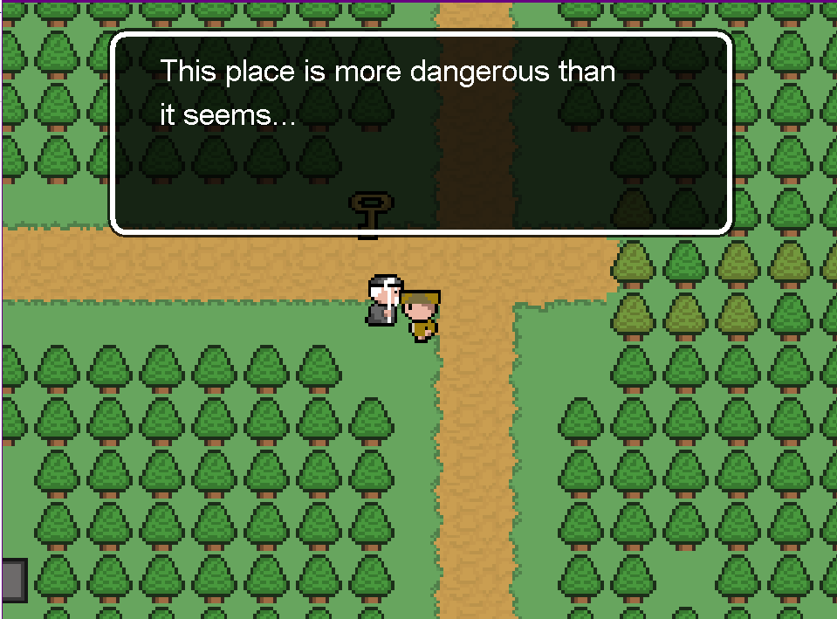

Slide 14
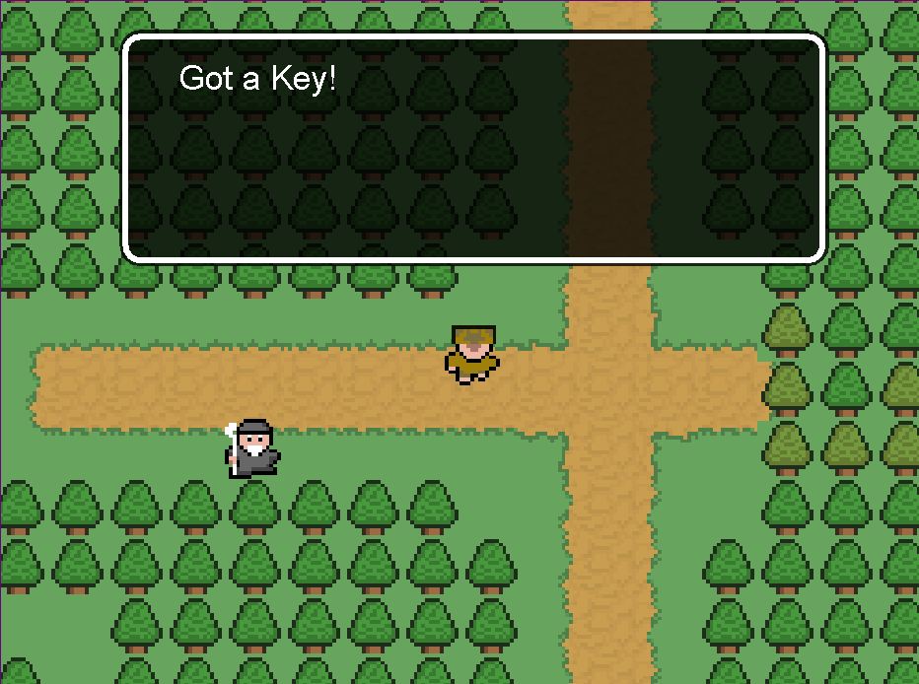

Slide 15
Conclusion
Thank you for listening

